Slide 1
PLP 2001C-Plant Pathology
Lecture 2
Notes:
Chapters 2 & 3 (Parasitism & Disease Dvlpmnt; Effect of Pathogens on Plant Physiological Fxns)

Slide 2
Parasitism & Disease Development
Infectious diseases result from a infection of a plant from a pathogen.
Parasite – organism that lives on or in some other organism and obtains its food from the latter.
Plant parasite – organism that becomes intimately associated with a plant and multiples or grows at the expense of the plant.
Pathogenicity – ability of a pathogen to cause disease.
Symbiosis – when both the plant & microorganism benefit.
Notes:
Pg77-103
Pl Patho’s belong to the same group of organisms that cause disease in plants & animals; however, none of the plant pathogens are known to cause disease in humans.
Go over definitions.
Path can grow/multiply on diseased plants, can more plants to become infected, lead to a large or small epidemic.
Removal by the parasite of H2O/nutr leads to decr in efficiency in normal grwth, becomes detr to further dvlpmnt.
Sym-legume w/ mcyhorr.

Slide 3
Parasitism & Disease Development
Additional damage results from substances secreted by parasite or host.
Pathogenicity is the ability of a parasite to interfere with one or more of the essential functions of the plant.
Success depends on the ability to invade host, feed & reproduce, withstand the conditions in which the host lives.

Slide 4
Parasitism & Disease Development
Obligate parasites – can grow & reproduce only on living hosts.
Biotrophs – fastidious bacteria, nematodes, rusts, mildews.
Nonobligate parasites – can live on either dead or living hosts & nutrient media.
Semi-biotrophs / facultative saprophytes.
Necotrophs / facultative parasites.
Notes:
Important distinction!
Most fungi & bact are nonobl.
Semi-live most of their time as parasites; neco-live most of their time on dead material.
Obli & Non-obl usually differ in ways they affect their hosts.
Many non-obl secrete enzymes that cause the disintegration of cell components.
Obl parasites do not kill cells in advance but get nutrients by either penetrating living cells or establishing close contact with them.

Slide 5
Parasitism & Disease Development
Numbers…
8,000 spp. of fungus.
200 spp. of bacteria.
1,000 spp. of viruses, 40 spp. of viriods.
500 spp. of nematodes.
2,500 spp. of higher plants.
Average number of diseases
Corn – 100.
Wheat – 80.
Apple & potato – 80 to 100.
Notes:
N Am stats
Single crop, tomato, may be attacked by >40 spp of fungi, 7 bact, 16 viruses, several mollicutes, & several nematodes.

Slide 6
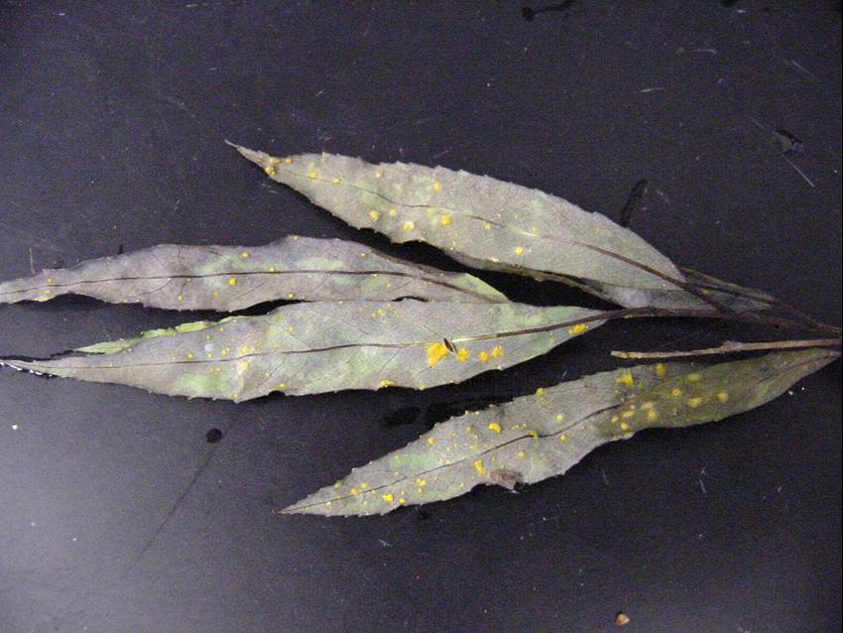
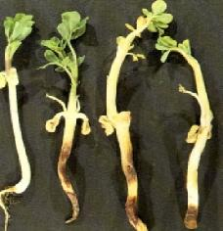
Parasitism & Disease Development
Host range of pathogens
Differ with respect to kinds of plants, which organs/tissues, age of organs/tissues
Obligate parasites more specific vs. Nonobligate parasites
Notes:
Obl par’s, however many viruses and nemas wider host range.

Slide 7
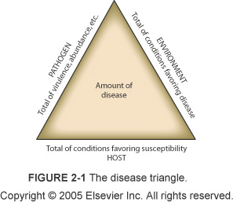
Disease Triangle
Notes:
Plant and path must come in contact & interact; conditions have to be right.
This 3rd component is the favorable environmental condition.
Rate of disease development dependent on these variables.
Length of a side is proportional to the sum total of the char of each component that favor disease.
**If any of the 3 components is zero, there can be no disease development.

Slide 8
Disease cycle
Chain of a series of more or less distinct events that occur in succession & lead to the development and perpetuation of the disease and pathogen.
Sometimes corresponds closely to pathogen life cycle.
Involves changes in the plant & its symptoms, in the pathogen; spans periods w/in a growing season or from one growing season to the next.
Notes:
In every infectious disease, a series of more or less distinct events occurs in succession & leads to the development & perpetuation of the disease & the pathogen.
This chain of event is called the disease cycle.

Slide 9
Disease cycle
Primary events
Inoculation
Penetration
Establishment of infection
Colonization (Invasion)
Growth / Reproduction
Survival
Notes:
Some diseases there may be several infection cycles within one disease cycle.

Slide 10
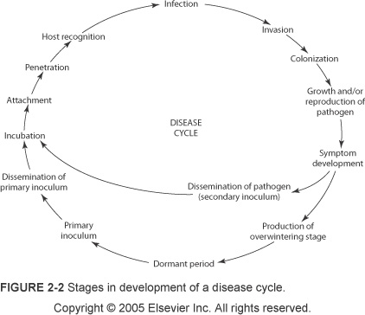
Disease cycle
Notes:
Very imp!

Slide 11
Inoculation
Initial contact of a pathogen with site of plant where infection is possible.
Inoculum is any part of the pathogen that can initiate infection and comes in contact with the host.
Types of inoculum
Primary vs. secondary.
The more abundant the primary inoculum and the closer to the crop, the more severe the disease.
Sources – vary greatly.
Arrival – wind, water, insects/animals.
Notes:
Inn for fungi can be spores, mycelium; for virus/bact whole individuals, nemas may be adult, juv, or eggs.
Primary inoculum causes the original infection (primary infections) from a dormant or survival state; secondary inoculum produced from primary infections and in turn causes secondary infections.
Diff sources depending on type of host (perr, etc), outside sources, alternative hosts.
Only small fraction of the potential inoculum produced actually lands on a susceptible host plants; majority lands on things that can’t become infected.

Slide 12
Prepenetration Phenomena
Pathogen attachment to host.
Spore germination/perception of host surface.
Appressorium formation/maturation.
Recognition between host & pathogen.
Germination of spores & seeds.
Hatching of nematode eggs.
Notes:
Attachment thru adhesion of spores, bacteria, and seeds. These adhesive materials come in contact with the plant surface.
Not exactly clear what causes germ.
Germ tube specialized strx distinct from fungal mycelium that grows short distance before it differentiates into an appressorium (needs signal from host plant).
Also have mechanism for preventing germ until favorable envr’l conditions occur.
App-hyphal "pressing" organ, from which a minute infection peg grows and enters the host (brings about penetration).
Secrete extracellular enzymes, generate phy force.
Generate great physical force to bring penetration of cuticle (size of turgor press has been measured to be 40x > than the press of a typical care tire.
Recognition mechanisms still unclear; numerous, when initial recogn signal received by the path favors growth/development disease may be induced, if signal suppresses pathogen growth/development disease may be aborted.
Germination (spores&seeds-par higher plants) requires favorable env conditions; some spores germinate by producing a typical mycelium that infects & grows into host plants or produce short germ tube that produces a specialized strx called a haustorium; some spores germinate by producing other spores while others are resting strx’s.
Germ often favored by nutrients/sugars diffusing from plant surface; antagonistic microbes in soil may cause an environment of starvation and of toxic metabolites. Fungistasis-spores unable to germinate in these soils, suppressive soils.
Nema eggs also require conditions of favorable temp & moisture; egg contains first juvenile stage, molts & 2nd juv stage emerges; attracted to roots by certain chemical factors assoc w/ root growth.

Slide 13
Penetration
Direct penetration of cell walls, natural openings, or through wounds.
Bacteria usually enter through wounds, less frequently through natural openings, never through cell walls.
Viruses, mollicutes, fastidious bacteria, and protozoa enter through wounds.
Parasitic higher plants by direct penetration.
Nematodes enter by direct penetration or natural openings.
Does not always lead to infection.
Notes:
Need susceptibility for infection to occur.
Viruses…wounds made by vectors, or those made by tools.
Fungi vary in penetration strategies; some in only one of these ways others in several.

Slide 14
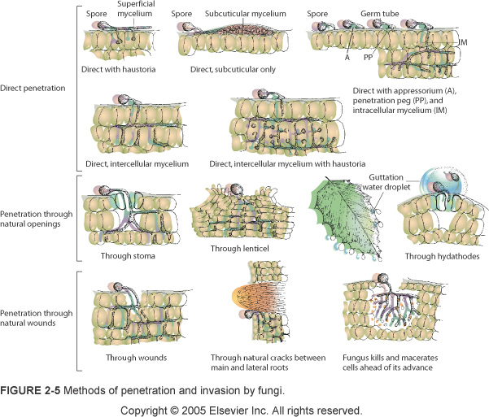
Notes:
Haustoria – simple or branched projection of hyphae into host cells that acts as an absorbing organ.
Hydathodes – strxs w/ 1 or more openings that discharge water form the interior of a lf to its surface.

Slide 15
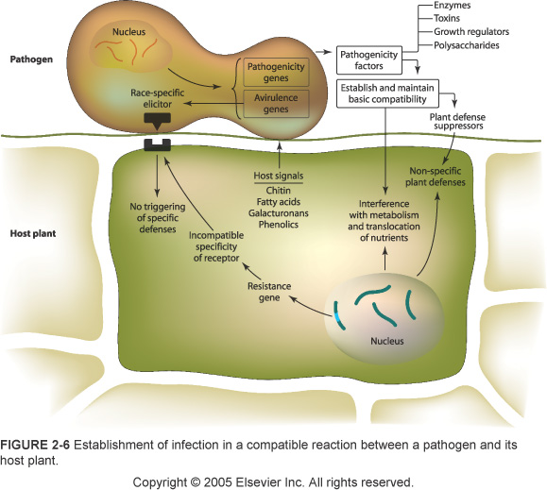
Notes:
Perception of signals from plant surfaces by pathogenic fungi seems to be the result of signaling pathways mediated by cyclic adenosine monophosphate (cAMP) & mitogen-activated proteins kinase (MAPK), which have been implicated in regulating the development of infection-related phenomena in many diff fungi.
In response to a signal from a host plant (presence of hydrophobic plant surface), which transmits a cue for appressorium formation, fungus perceives the extracellular signal & its transmission via the plasma membrane and, as a first step, it accumulates intracellular signaling molecules and induces a phosphorylation cascade.

Slide 16
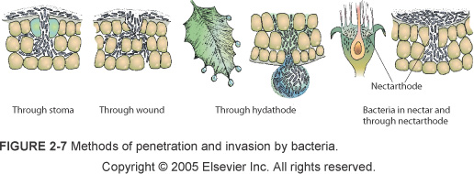
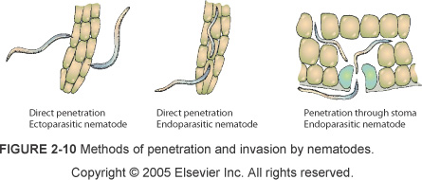

Slide 17
Direct Penetration
Most common by fungi, oomycetes, nematodes, and only type by parasitic higher plants.
Nonobligate – fine hypha produced directly by the spore or mycelium.
Obligate parasites – penetration peg produced by an appressorium.
Notes:
Through intact plant surfaces.
Pierces the cuticle and the cell wall thru mechanical force & enzymatic softening.
PHP also form a appr and penetration peg from radicle.
Nemas thru back/forth movement of stylets.

Slide 18
Penetration through Wounds
All bacteria, most fungi, some viruses, and all viroids through various types of wounds.
Pathogens grow briefly on wounded tissue before entering healthy.
Weather, animal feeding, insects, cultural practices.
Some viruses, all mollicutes, fastidious vascular bacteria, and protozoa enter through wounds made by the vector.
Deposition by vectors in fresh wounds created at time of inoculation.
Insects, nematodes, mites, fungi.
Notes:
Discuss differences bw these 2 methods

Slide 19
Penetration through Natural Openings
Many fungi & bacteria.
Types of openings
Stomata- most numerous on the lower side of the leaves.
Hydathodes – pores at the margins & tips of leaves.
Nectarthodes – in blossoms, similar to hydathodes.
Lenticels – openings on fruits, stems, & tubers that allow for air exchange.
Notes:
St-open in daytime, closed at night
Hyd-more or less permanently open; connected to veins and secrete droplets of liquid (guttation drops)
Nec-bact, few fungi
Lent-less efficient, secondary pathway for infection

Slide 20
Infection
“Process by which pathogens establish contact with susceptible cells or tissues of the host and procure nutrients from them”.
Successful infections result in the appearance of symptoms.
Some infections remain latent.
Symptoms are all the visible and otherwise detectable changes in infected plants.
Notes:
Following infection, pathogens grow, multiply, or both w/in the plant tissues & invade & colonize the plant to a certain extent.
Gwth and/or repro of the path (colonization) in or on infected tissues are actually 2 concurrent substages of disease dvlpmnt.

Slide 21
Infection
Incubation period is the time interval between inoculation and appearance of disease symptoms.
Length varies greatly depending on pathogen-host combination, stage of development of the host, temperature in the environment of infected plant.
For infection to occur pathogen has to come in contact with host and:
Plant must be susceptible & at susceptible stage.
Pathogen must be in a pathogenic stage.
Temp & moisture in plant environment to favor growth/multiplication of pathogen.
Notes:
Symptoms may appear as soon as 2-4 days after inoculation or as late as 2-3 years (some viral, mollicute, other diseases of trees).
Some pathogens kill cells to obtain nutrients, others obtain nutrients from living cells.

Slide 22
Invasion
Most fungi spread into all the tissues of the organ they infect.
Intracellular mycelium – through cells.
Intercellular mycelium – between cells.
Bacteria invade intercellulary, but when parts of the cell walls dissolve grow intracellulary.
Vascular wilt pathogens invade xylem vessels.
Viruses, mollicutes, fastidious bacteria, protozoa invade cells intracellulary.
Nematodes mostly intercellulary.
Notes:
Gone over various methods already.
Nema’s can invade intra also, many feed by just piercing cells.

Slide 23
Local vs. Systemic
Local
Single cells, few cells, or small area.
May remain localized throughout growing season.
Some grow slowly, others enlarge rapidly.
Systemic
Xylem or phloem inhabiting.
Spreads and invades plant from one initial point.
Notes:
Many infections caused by fungi, back, nema’s, viruses, & parasitic higher plants are local…
May remain localized throughout growing season or may enlarge slightly or very slowly.
Other infections enlarge more or less rapidly & may involve an entire plant organ (flwr, fr, lf), a large part of the plant (branch), or the entire plant.
Infections caused by fastidious xylem or phloem inhabiting bact, mollicutes, & protozoa as well as natural infections caused by viruses & viroids are systemic…
Pathogen from one initial point of infection spreads & invades most or all susceptible cells & tissues throughout the plant.

Slide 24
Colonization
Same pathogen individual spreads into more and more plant tissues until the spread of the infection is stopped or plant dies.
Mycelium, spores in vascular system.
Pathogen reproduce in a variety of ways.
Fungi – asexual or sexual.
Parasitic higher plants – seeds.
Bacteria & mollicutes – fission (1 individual splits into 2).
Viruses & viroids – replicated by cell.
Nematodes – eggs.
Notes:
Individual fungi & parasitic higher plants generally invade & infect tissues by growing on into them from one initial point of inoculation.
Diseased plant may have several points where separate units of mycelium are active.
Fungi causing vascular wilts invade plants by producing & releasing spores w/in the vessels, & as the spores are carried in the sap stream they invade vessels far away from the mycelium, germinate there, & produce a mycelium which invades more vessels.
Go over different reproduction methods.

Slide 25
Pathogen Dissemination
Few pathogens can move short distances on their own power.
Some spores, seeds are expelled forcibly.
Air, water, insects, mites, nematodes, animals, pollen, seeds, transplants, budwood, nursery stock, humans.
Notes:
Ex-nematodes, oomyctes, zoo-sporic fungi, bact.

Slide 26
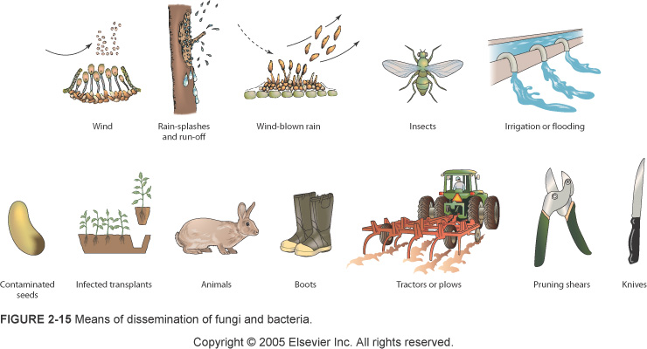
Pathogen Dissemination
Notes:
Air-certain spores (rusts) very hardy, high altitudes (several thousand meters) above infected fields
Water-1.Bact,nemas, spores diss by water that moves on surface, 2.All bact, some spores in sticky liquid, need water splash to wash downward or splash in all directions, 3. Rain drops, OH irr, spores & bact present in air to wash downward
Insects; Viruses-aphids, whiteflies, thrips, leafhoppers; other insects (may be specific or general)
Some viruses can be carried in the pollen
Humans-TMV, many other examples

Slide 27
Overwintering and/or Oversummering
Annuals, pathogens may be left without a host for months; mechanism for pathogen to survive the cold winters or dry summers.
Mycelium, resting spores, sclerotia, as soil inhabitants, soil transients, alternate hosts.
Viruses, viroids, mollicutes, fastidious bacteria, and protozoa survive only in living plant tissue.

Slide 28
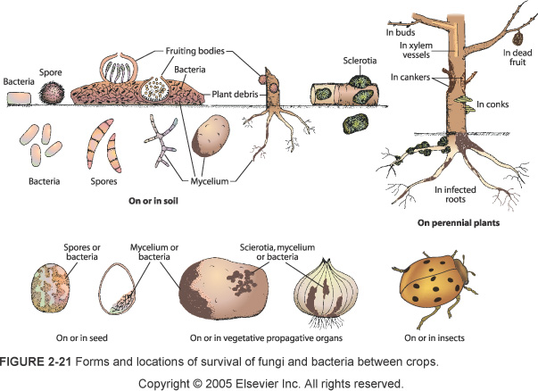

Slide 29
Disease Cycles and Epidemics
Single-cycle (monocyclic)
Complete only one, or even part of one, disease cycle in year 1
Smuts, certain rusts, root rots, vascular wilts
Primary inoculum is the only one available for entire season
No secondary inoculum and no secondary infection
Multicyclic (polycyclic)
Can complete many disease cycles per year
Inoculum amount is multiplied many fold
Downy mildew, late blight, powdery mildew, grain rusts, viruses
Monocyclic that take more than 1 year – Polyetic
May cause epidemics under favorable conditions
Notes:
Mono may increase steadily from year to year
Poly includes explosive epidemics
Polyetic-dutch elm disease, cedar apple rusts, white pine blister rust, citrus tristeza

Slide 30
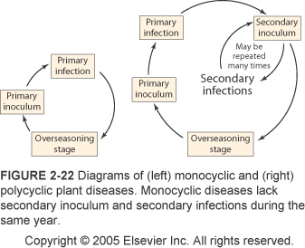
Monocyclic vs. Polycyclic

Slide 31
Effect of Moisture
Influences initiation & development of plant diseases.
Exists as different forms.
Rain
Irrigation water
Relative humidity
Dew
Fungal diseases.
Spore germination, longevity, germination of spores.
Number of infection cycles.
Notes:
Pg251-262, 271-272
**Dominant factor
Also plays important role in distribution
Occurrence of many diseases closely correlated with amount & distribution of RF w/in the year
Ex: apple scab - continuous wetting of the leaves, fruit for at least 9 hrs required at opt temp range (18-23C)
**Most pathogens become independent of outside moisture once they can obtain nutr & water from plant (exceptions are late blight, dm); in pm spore germination & infection are actually lower in the presence of free moisture of the plant

Slide 32
Effect of Moisture
Underground diseases
Oomycetes, damping off & root rots
Severity of disease is proportional to the amount of soil moisture and is greatest near saturation point
Pathogen spreads best in wet soils
High soil moisture may also decrease ability of host to defend itself
Other soil pathogens
Notes:
Those affecting roots, tubers, young seedlings
Water logged soils – reduced oxygen ability and lower temp
Other-fungi, bact, nemas cause most severe symp when soil is wet but not saturated
Several other fungi (Fusarium) grow fairly well in rather dry environments
Vascular wilts caused by Verticillium when plants suffer from water stress

Slide 33
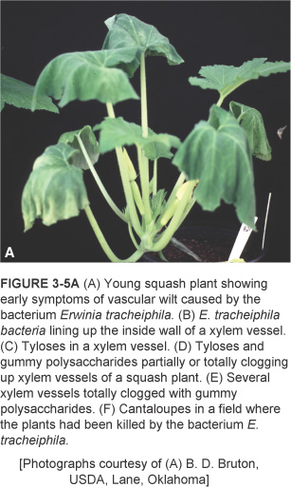
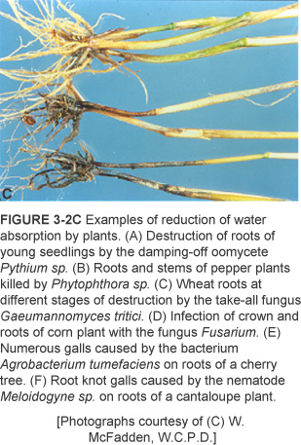
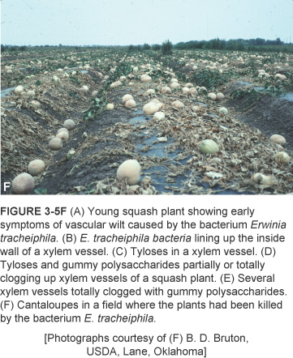
Effects of Pathogens of Plant Physiological Functions
Pathogens interfere with the different physiological function(s) and lead to development of different symptoms.
Notes:
Pg105-121
Ex’s- flowers/ability to reproduce; roots/ability to absorb nutrients
While pathogens infect plants in the course of their obtaining food for themselves, depending on the kind of path & on the plant organ or tissue they infect, pathogens interfere w/ the diff physiological fxns of the plant & lead to the dvlpmnt of diff symptoms.

Slide 34
Different Physiological Functions
Photosynthesis
Water/Nutrient Translocation
Host plant respiration
Permeability of cell membranes
Transcription & translation
Plant growth
Plant reproduction
Notes:
List of diff phys fxns that may be affected by plant pathogens.

Slide 35
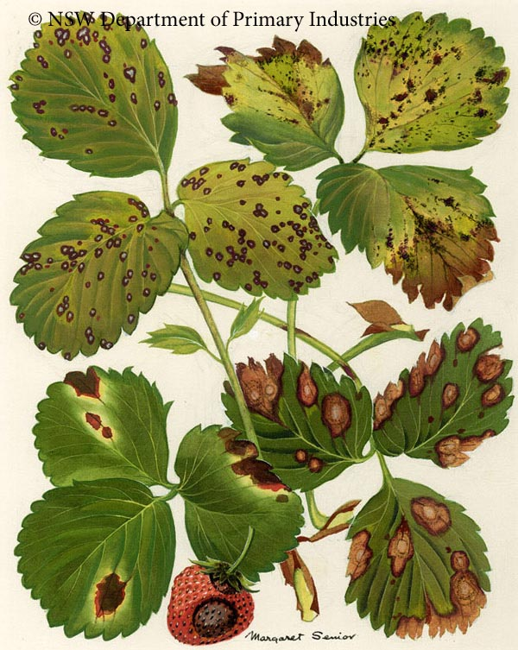
Pathogen Effect on Photosynthesis
Ps is the ultimate form of energy; basic function of green plants
Chloroplasts – organelle where Ps occurs
Reduced due to a decrease in the photosynthetic leaf surface
Certain fungal & bacterial diseases, overall chlorophyll content reduced
Notes:
What happens in chloroplasts
Leaf spots, blights, rusts, viral mosaics, yellowing & stunting diseases, defoliations
Toxins may inhibit certain enzymes directly/indir involved in Ps

Slide 36
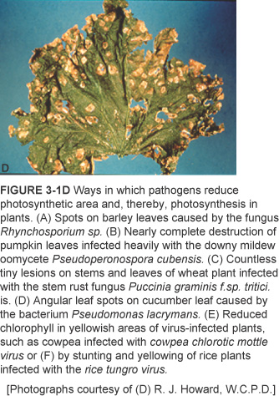
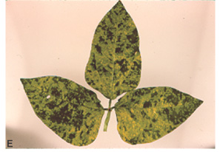

Slide 37
Water/nutrient Translocation
Roots absorb water, nutrients/minerals from soil.
Diseased conditions result in the plant parts denied these essential materials.
Upward translocation of water/nutrients.
Integrity of roots, absorb less water/nutrients
Growing in the xylem vessels
Nutrients in the phloem
Effecting transpiration
Notes:
1a-Daming off fungi, root-rotting nema’s, bact; directly affect the function of the root system
1b-Mentioned above may reach xylem vessels; cankers in stems, galls (crown gall back, clubroot protozoon, RK nemat) – most typical and complete dysfunction of the xylem vasc wilts (Ceratyo, Fusarium, Verticillum, Ralstonia, Erwinia)
1c-sugars from lvs; path clogs-obligate fungal parasites (rusts, mildews); cankers, some bact, phytoplasmas
1D-path infects lvs; destruction at least of part of cuticle protection, incr in cell perm, dysfunction of the stomata (rusts, pm)

Slide 38
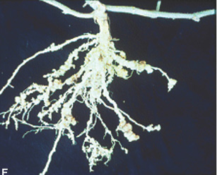
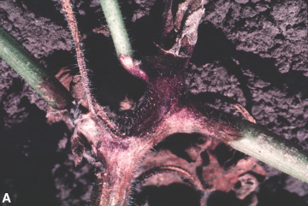

Notes:
Examples of reduction of water absorption by plants
C-Wheat roots at diff stages of destruction by the take-all fungus Gaeumannomyces tritici.
F-Root knot galls caused by the nematode Meloidogyne sp. on roots of a cantaloupe plant.
A-Stem of a cantelope plant infected with the fungus Phomopsis sp.
A-Young squash plant showing early symptoms of vascular wilt caused by Erwinia tracheiphila.

Slide 39
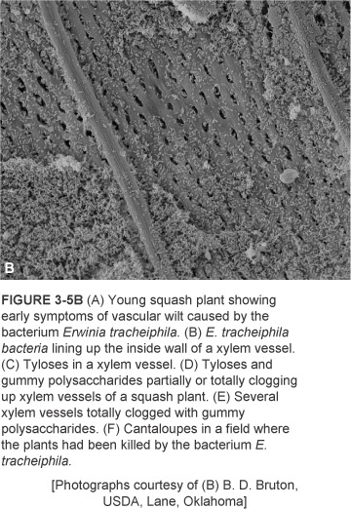
Notes:
Erwinia tracheiphila bacteria lining up the inside wall of a xylem vessel.

Slide 40
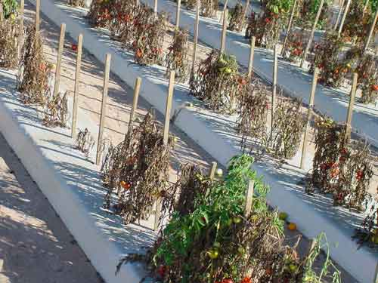
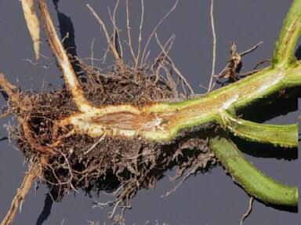
Notes:
Translocation issues – tomato infected with a vascular wilt pathogen (Fusarium sp.)

Slide 41
Host Plant Respiration
Cellular process that releases energy in held in carbohydrates and fatty acids.
Carried out in mitochondria.
Infection usually causes increase depending on susceptibility status.
Plant is forced to produce energy in less efficient ways (ADP, ATP affected).
Notes:
Susc-incr more rapidly in infectious of resistant varities; susc var incr slowly then stays high.

Slide 42
Cell Membrane Permeability
Double layer of lipid molecules.
Function as permeability barrier.
Uncontrollable loss of usable substances.
Most commonly observed effect is loss of electrolytes (small water-soluble ions and molecules).
Notes:
Cell membr background/fxns-barriers that allow certain substances into the cell.

Slide 43
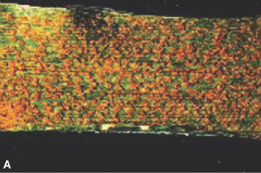
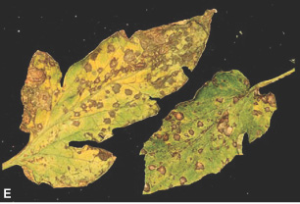
Notes:
Ways by which pathogens cause increased transpiration in infected plants.
A- The wheat leaf rust pathogen Puccinia recondita produces innumerable lesions (uredia) on wheat lvs & causes millions of breaks in the lf epidermis through which transpiration goes on uncontrollably.
E- Tomato lvs w/ numerous lesions caused by the fungus Septoria sp. & through which excessive transpiration occurs.

Slide 44
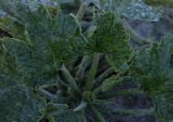
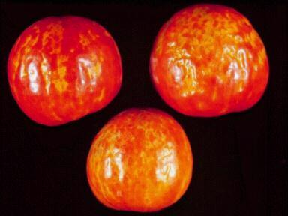
Transcription & Translation
Transcription of cellular DNA into messenger RNA, & translation of messenger RNA to produce proteins.
Disturbance may cause drastic, unfavorable changes in the structure and function of affected cells.
Notes:
2 of the most basic, general, and precisely controlled processes in the biology of any normal cell.
Transcr: Viral, obligate fungal parasites (rusts, pm);
**Especially true for viruses (through enzymes/RNA uses host cell nucleotides and machinery to make its own RNA).
Transl: increased protein syn.

Slide 45
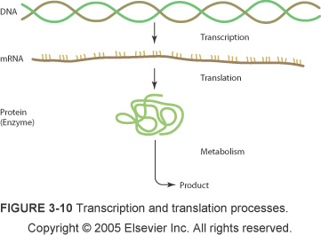

Slide 46
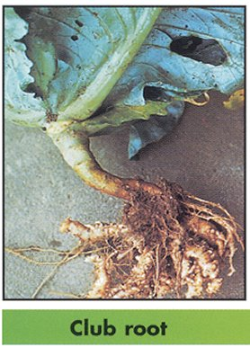
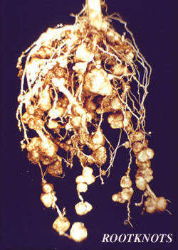
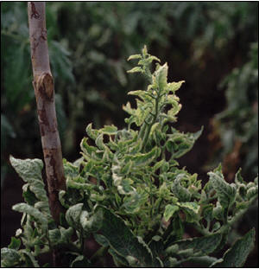
Plant Growth
Growth regulators affecting cell division.
Clubroot of crucifers, leaf curls, warts, galls, cankers.
Viruses – stunting, leaf deformation, abnormal fruit shapes.
Notes:
Talking about abnormal growth; very little is known about the specific compounds & mechanisms involved or the genes that control these events.

Slide 47
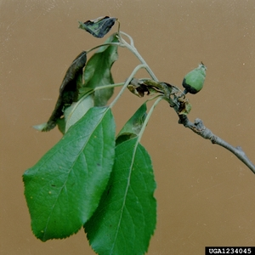
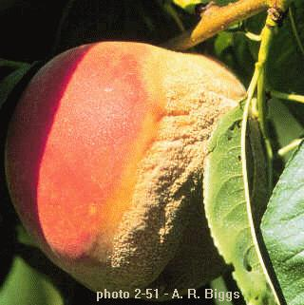
Plant Reproduction
Infected plants often produce fewer flowers, set fewer fruit & seed (less vigorous).
Pathogens may directly infect flowers.
Brown rot of stone fruits, Fireblight of pears & apples, Premature fruit drop in citrus.
Notes:
Fungal and bact; BR-Monilinia, FB-Erw, PremFrDr-Collet.

Slide 48
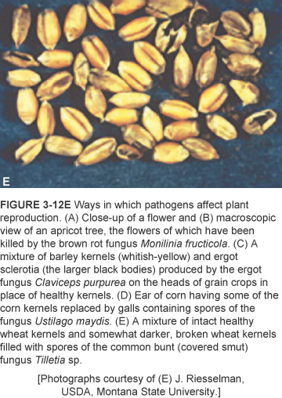
Notes:
Mixture of intact healthy wheat kernels & somewhat darker, broken wheat kernels filled w/ spores of the common bunt (covered smut) fungus Tilletia sp.

